Slide 1
Radar Project Feedback

Slide 2
Lidar and Radar Fusion with Kalman Filters in C++

Slide 3
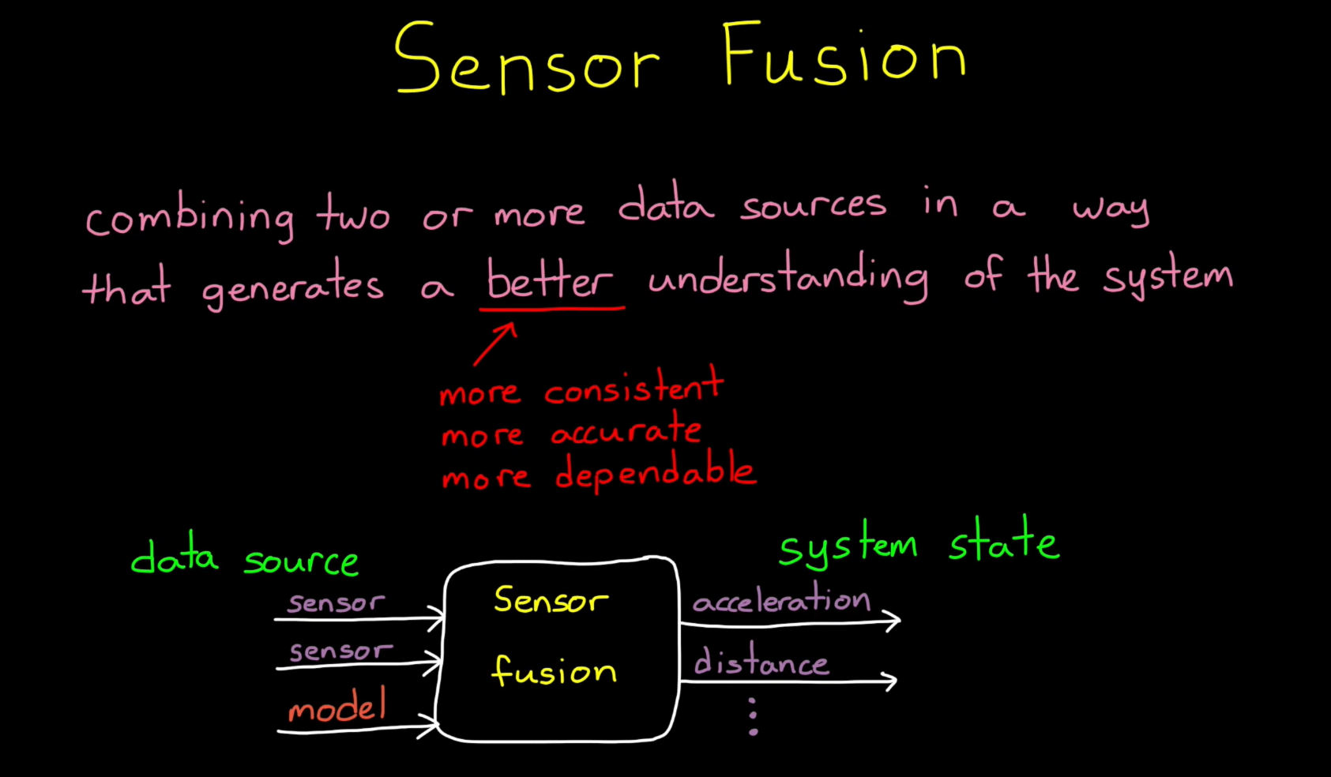


Slide 4
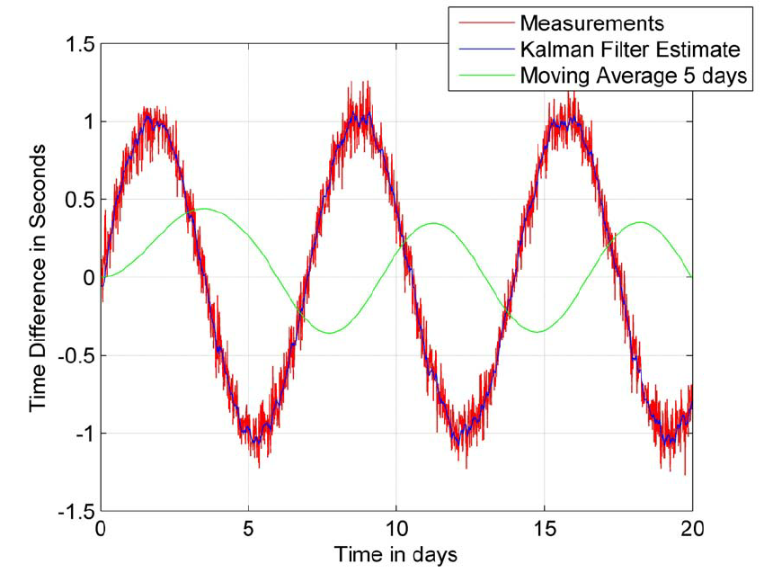
Kalman Filter Results

Slide 5
Measurement Refinement using Kalman filter

Slide 6
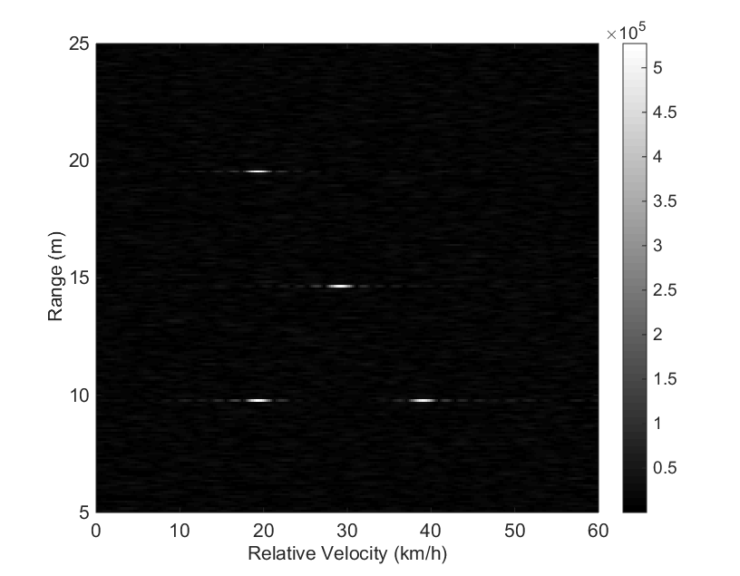
Range Velocity Map [Radar/Lidar]

Slide 7
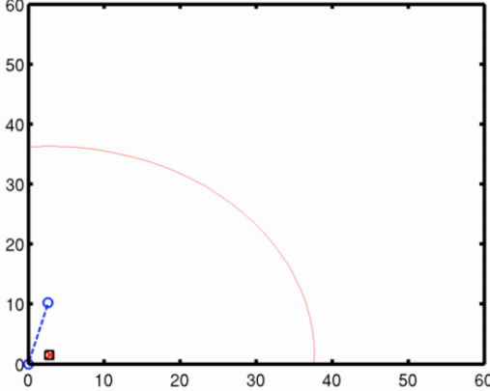
KALMAN Filter

Slide 8

KALMAN Filter

Slide 9
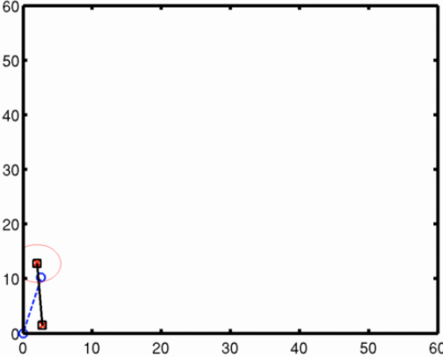
KALMAN Filter

Slide 10
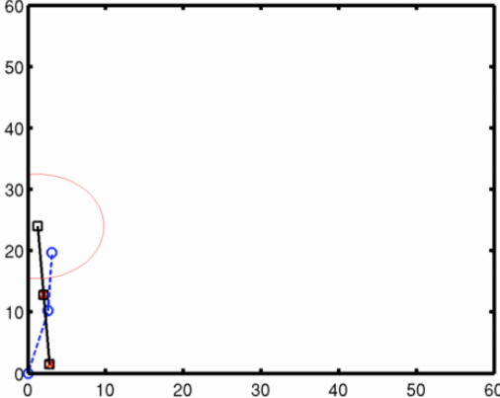
KALMAN Filter

Slide 11
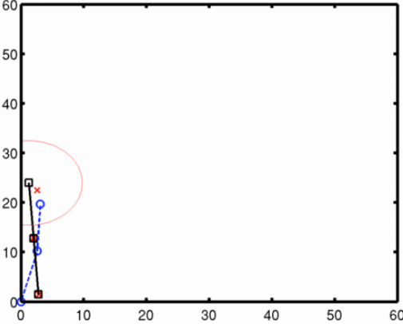
KALMAN Filter

Slide 12
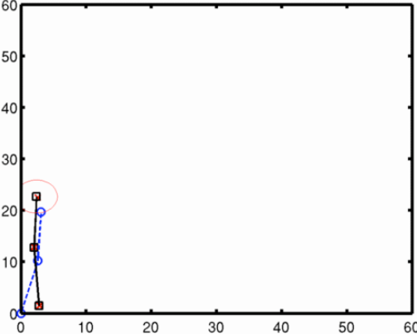
KALMAN Filter

Slide 13
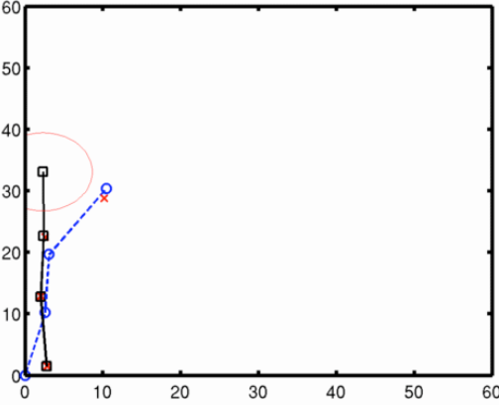
KALMAN Filter

Slide 14
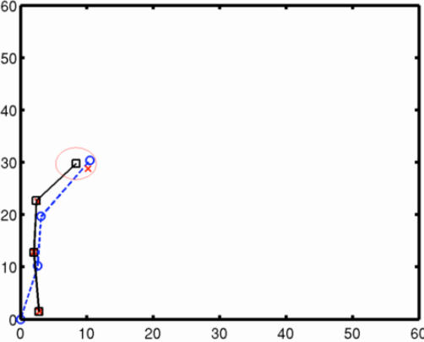
KALMAN Filter

Slide 15
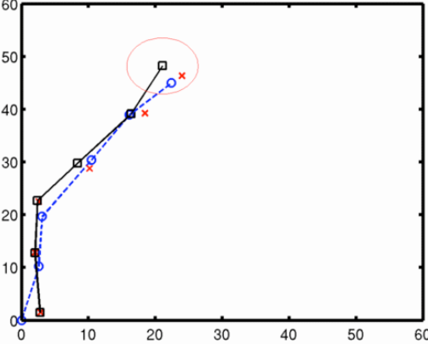
KALMAN Filter

Slide 16
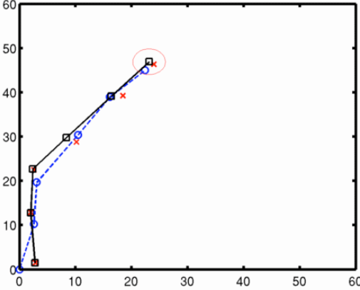
KALMAN Filter

Slide 17
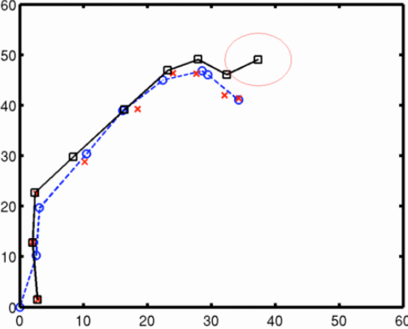
KALMAN Filter

Slide 18
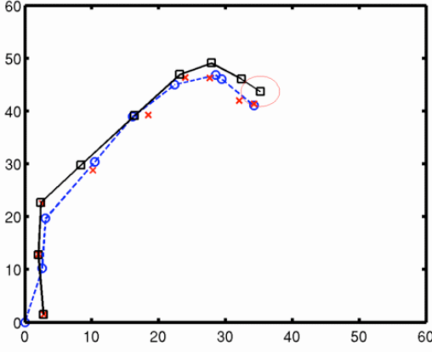
KALMAN Filter

Slide 19
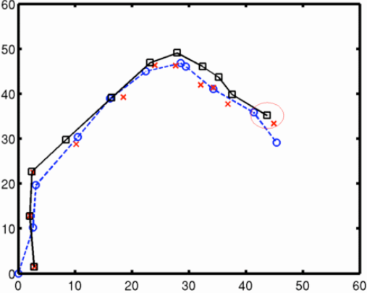
KALMAN Filter

Slide 20
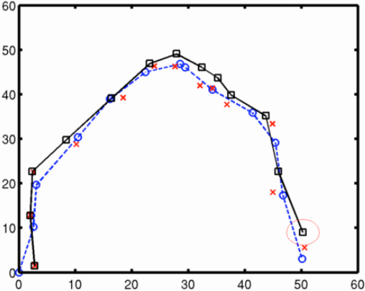
KALMAN Filter

Slide 21
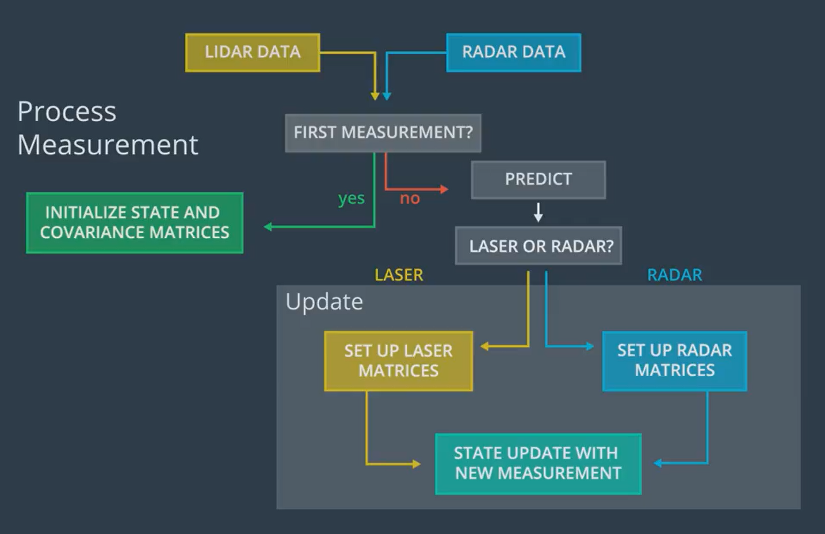
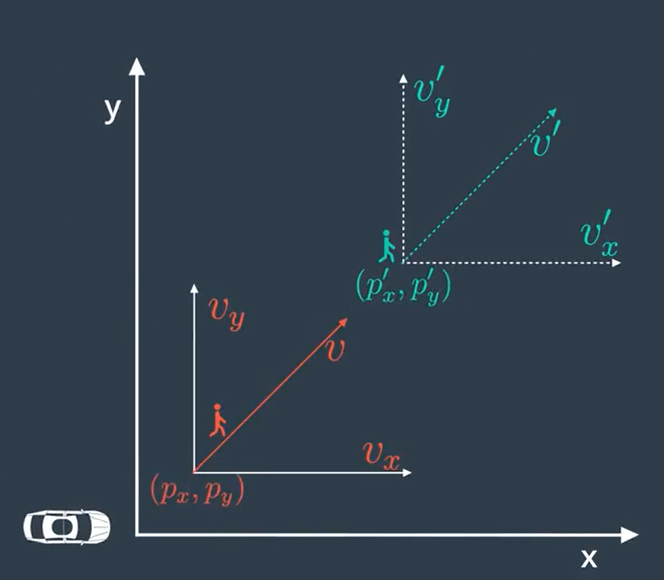
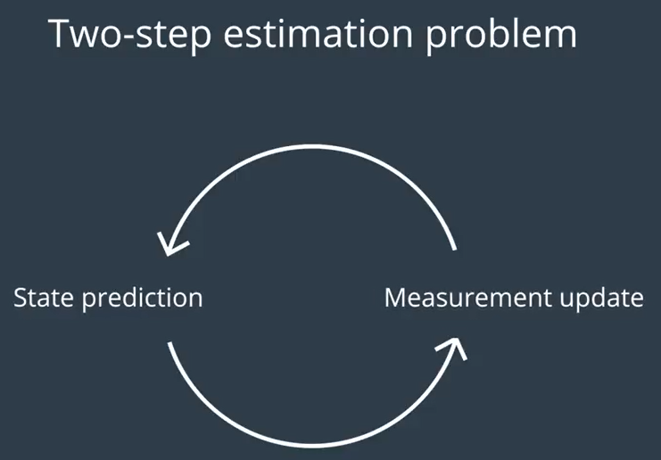
Lidar-Radar Measurements Fusion

Slide 22
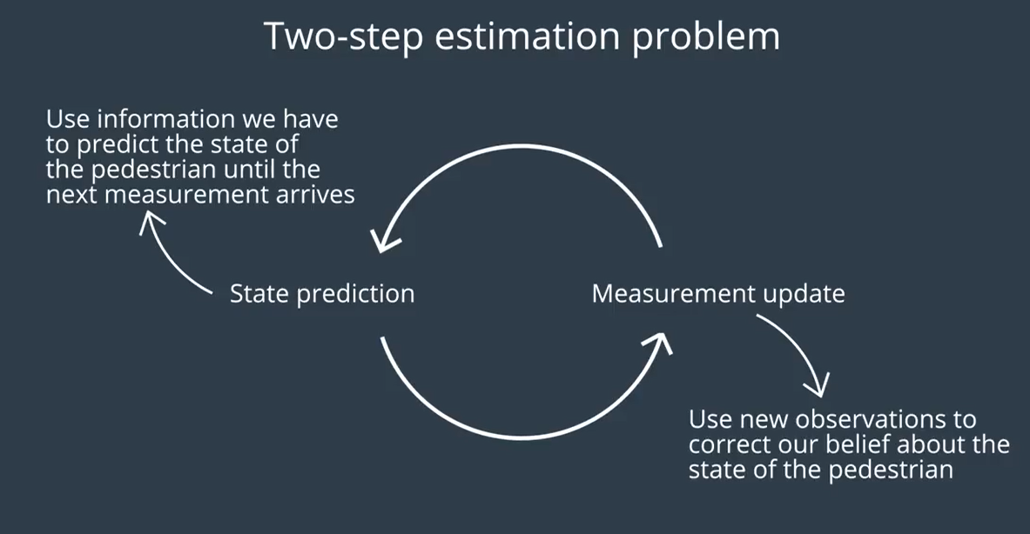

Slide 23
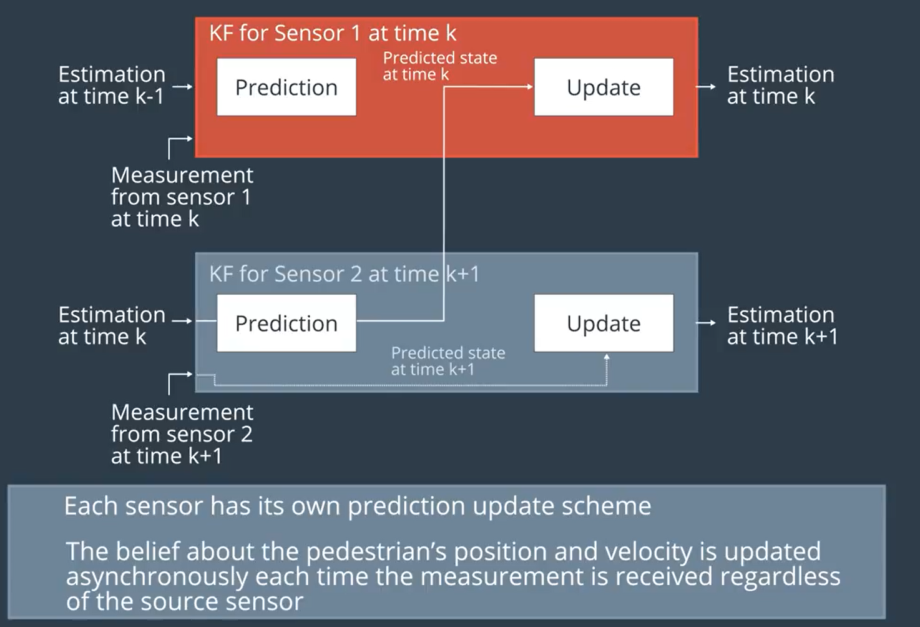
Lidar
+
Radar

Slide 24
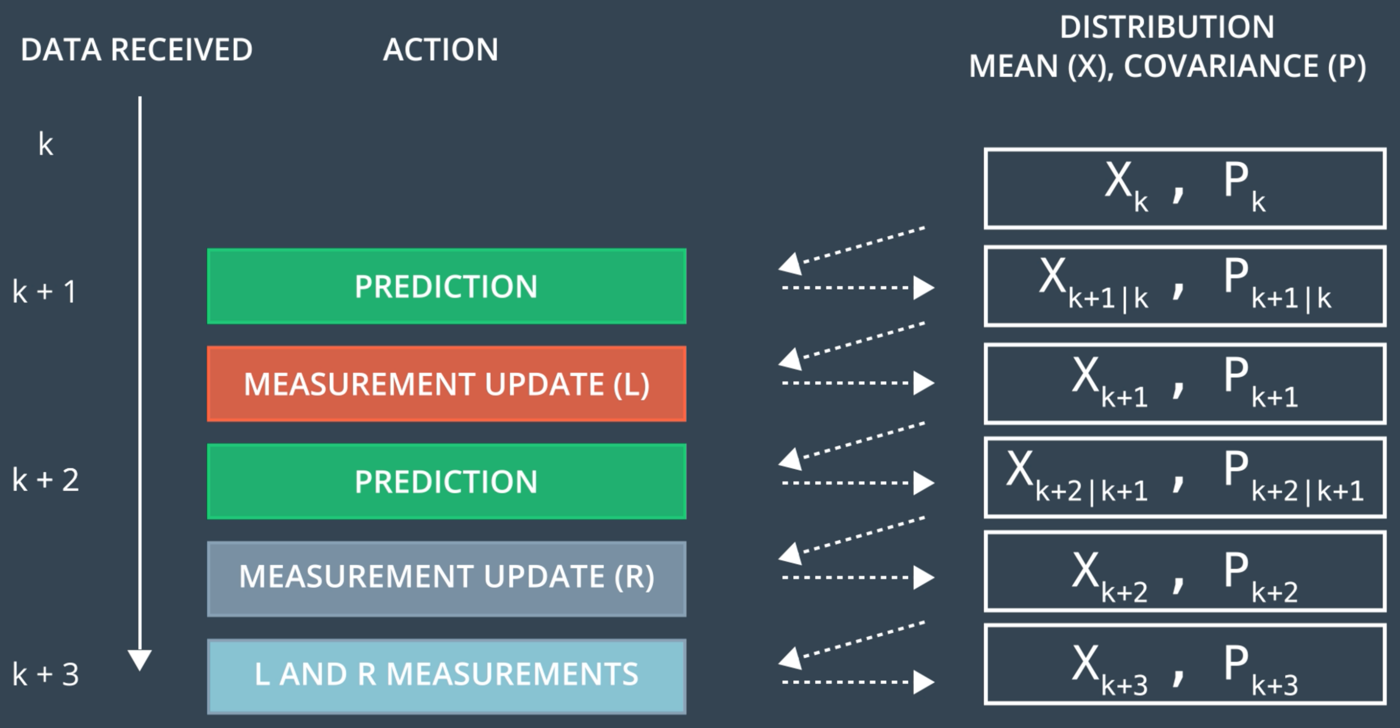


Lidar + Radar
?

Slide 25
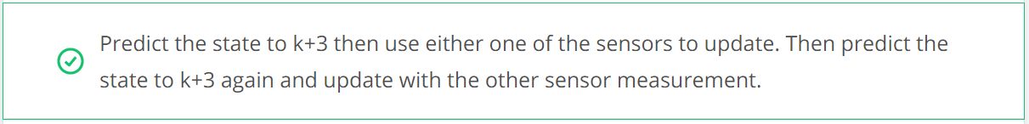
Lidar + Radar
Because we have already run a prediction-update iteration with the first sensor at time k+3, the output of the second prediction at time k+3 will actually be identical to the output from the update step with the first sensor.
So, in theory, you could skip the second prediction step and just run a prediction, update, update iteration.

Slide 26
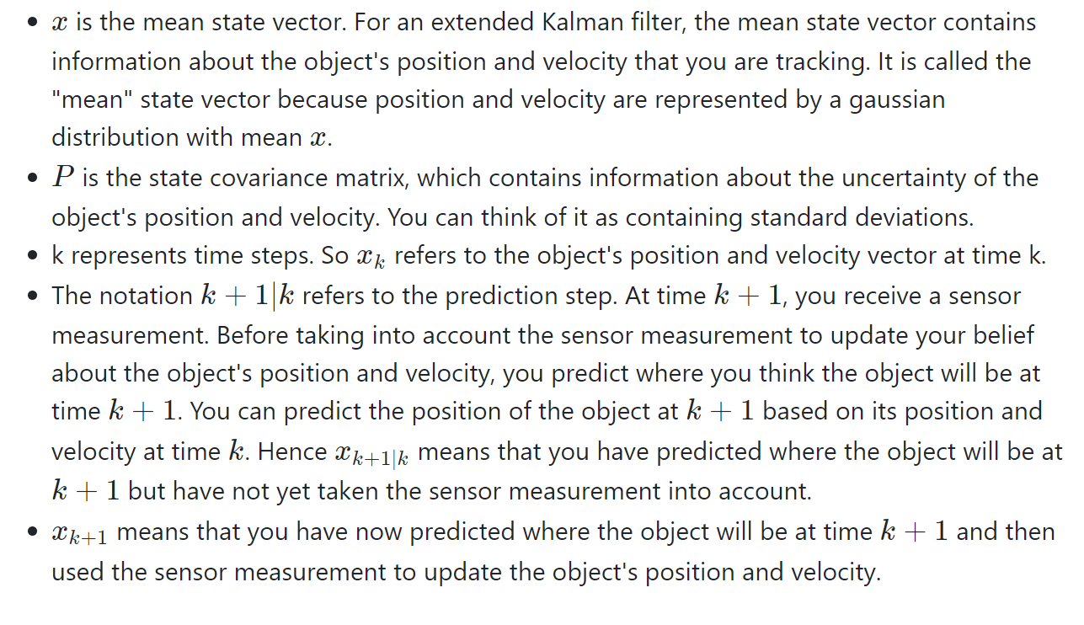
Definition of Variables

Slide 27
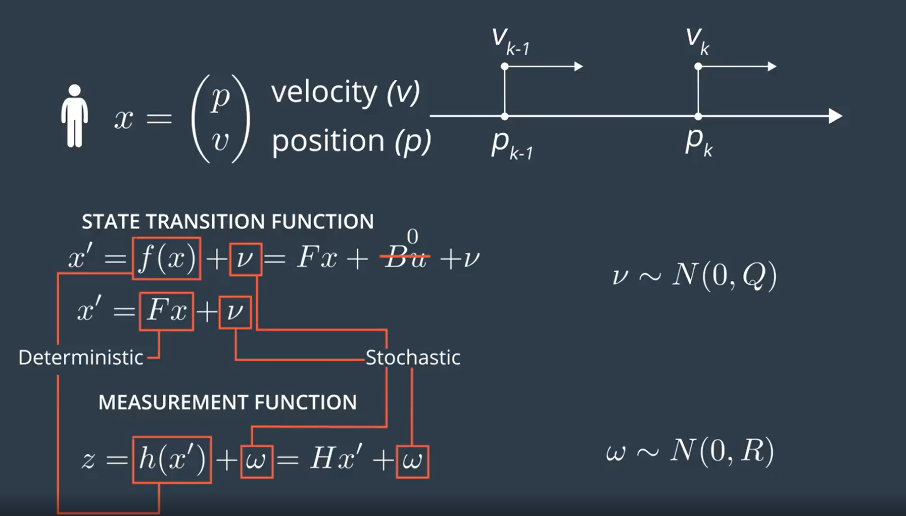

Kalman Filter Equations
Process Noise
i.e. mean
i.e. Covariance
Measurement Noise

Slide 28
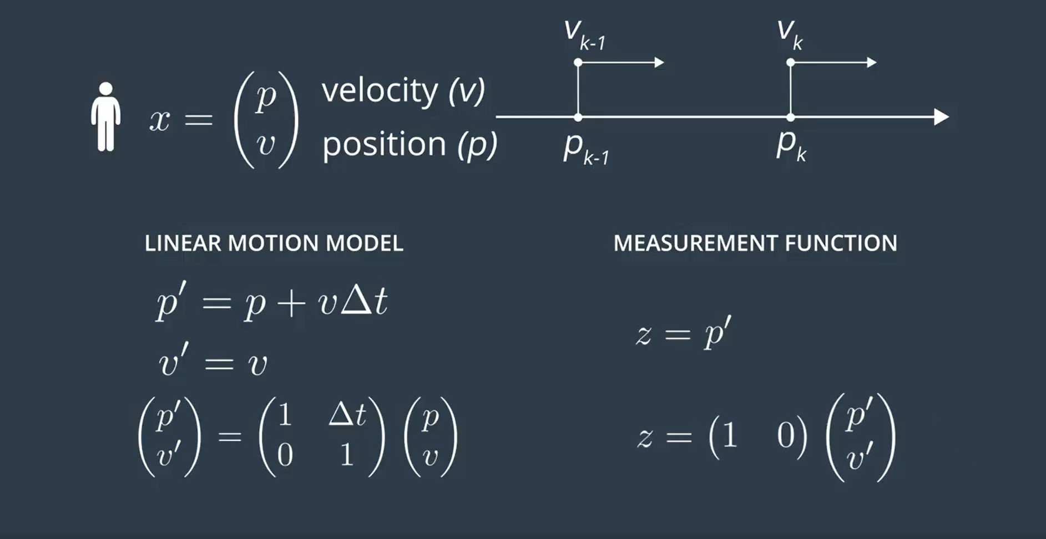
Kalman Filter Equations
F
H

Slide 29
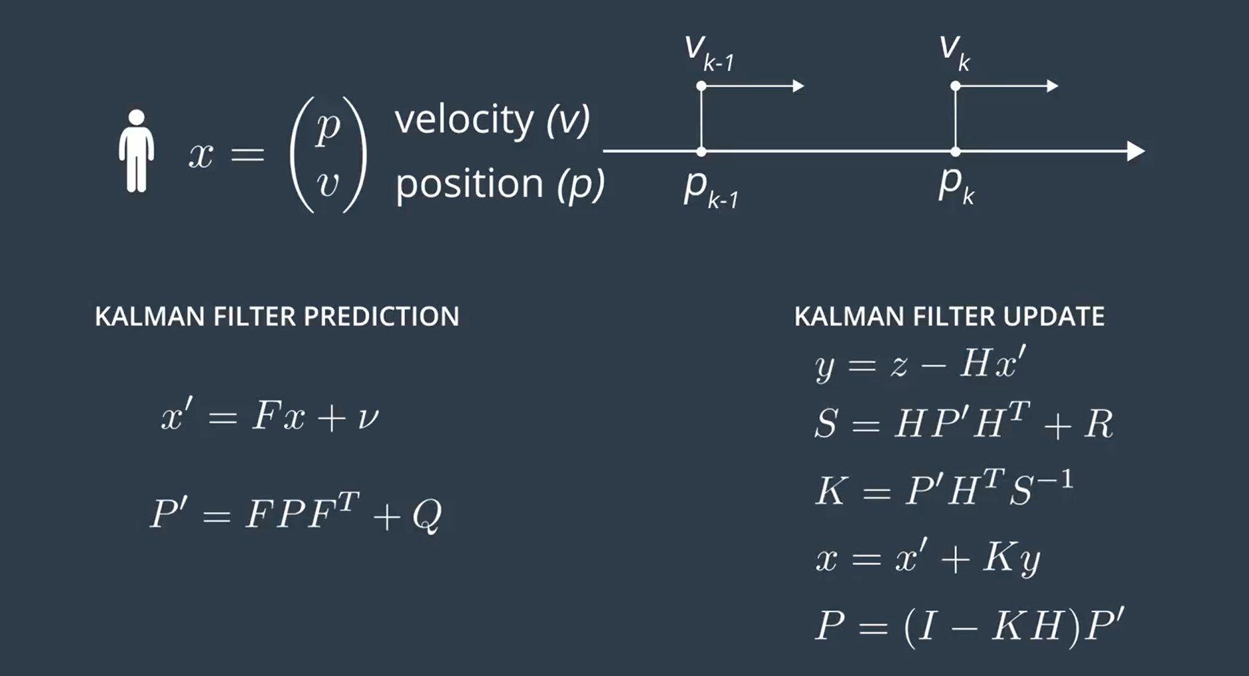
Kalman Filter Equations
Measurement Transformation Matrix
Meas. Vector
State Vector update
state Transformation matrix
Measurement noise Covariance Matrix
Process noise
state Vector
Kalman Gain
Process noise Covariance Matrix
State Covariance Matrix update
State Covariance Matrix

Slide 30
Kalman Filter Equations in C++
Code: tracking_1d.cc
P,R value initial values

Slide 31

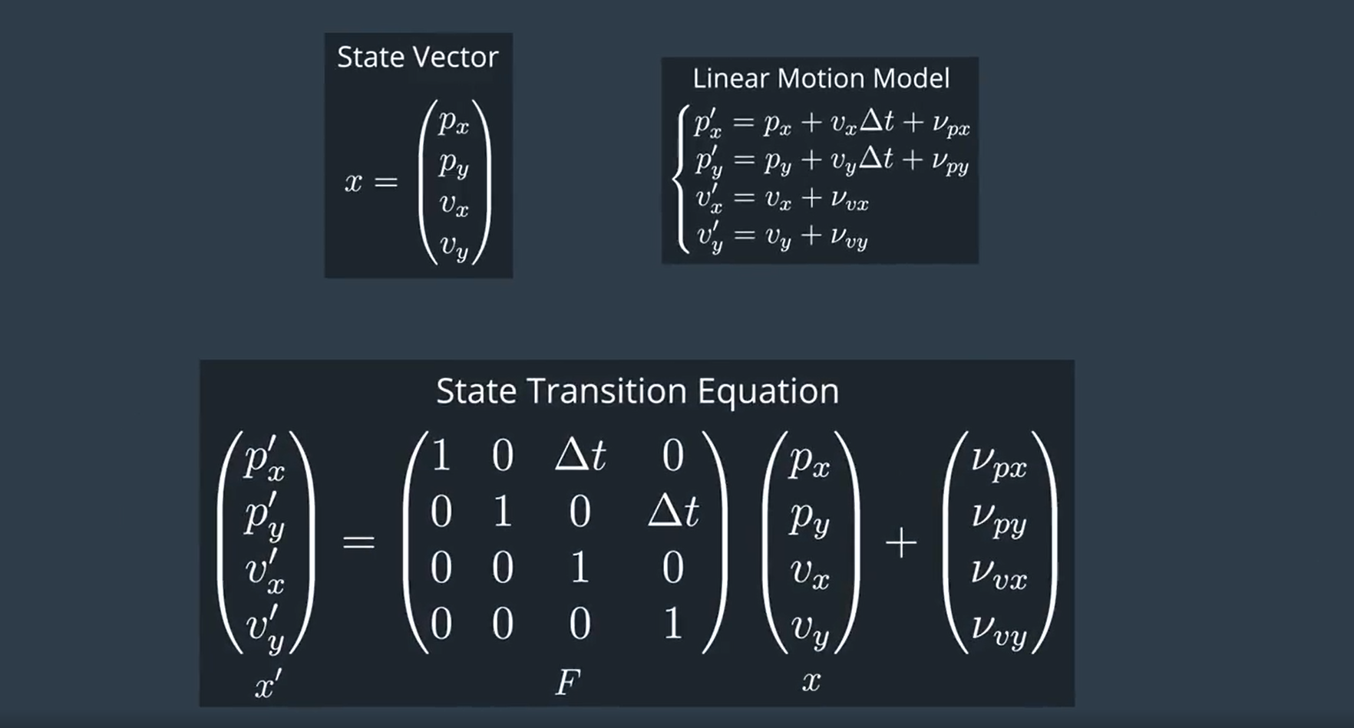
2D Linear Motion Model (Constant Velocity model)

Slide 32
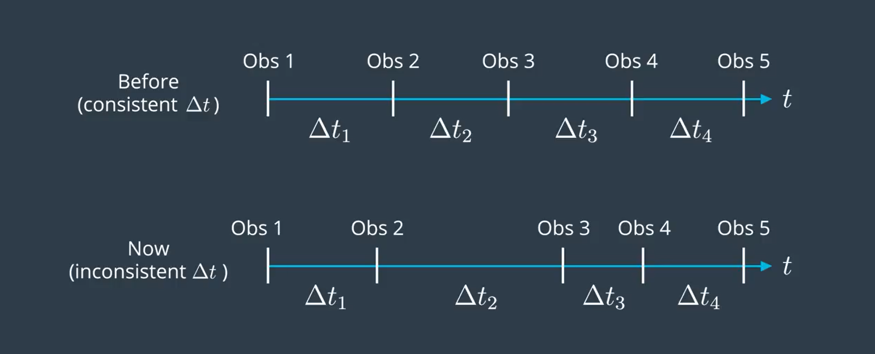
Measurements could come in inconsistent delta t
The process noise depends on both: the elapsed time and the uncertainty of acceleration.

Slide 33
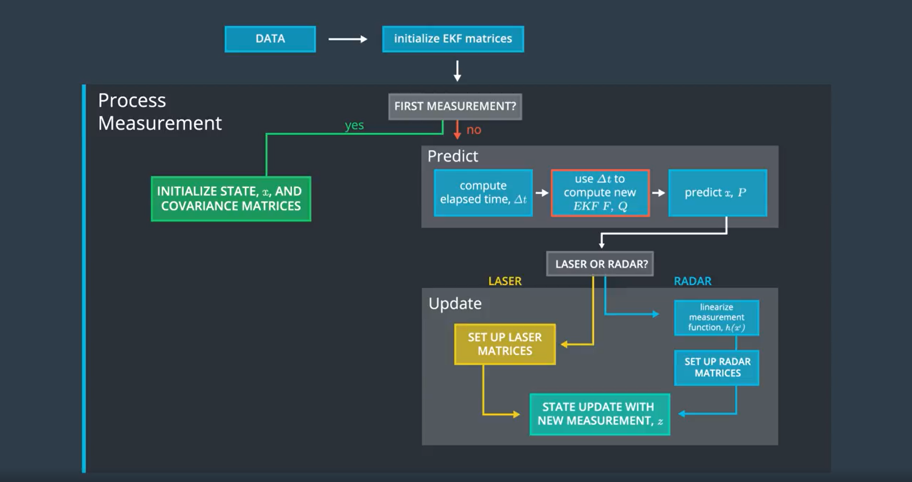
Kalman Filter Road Map

Slide 34
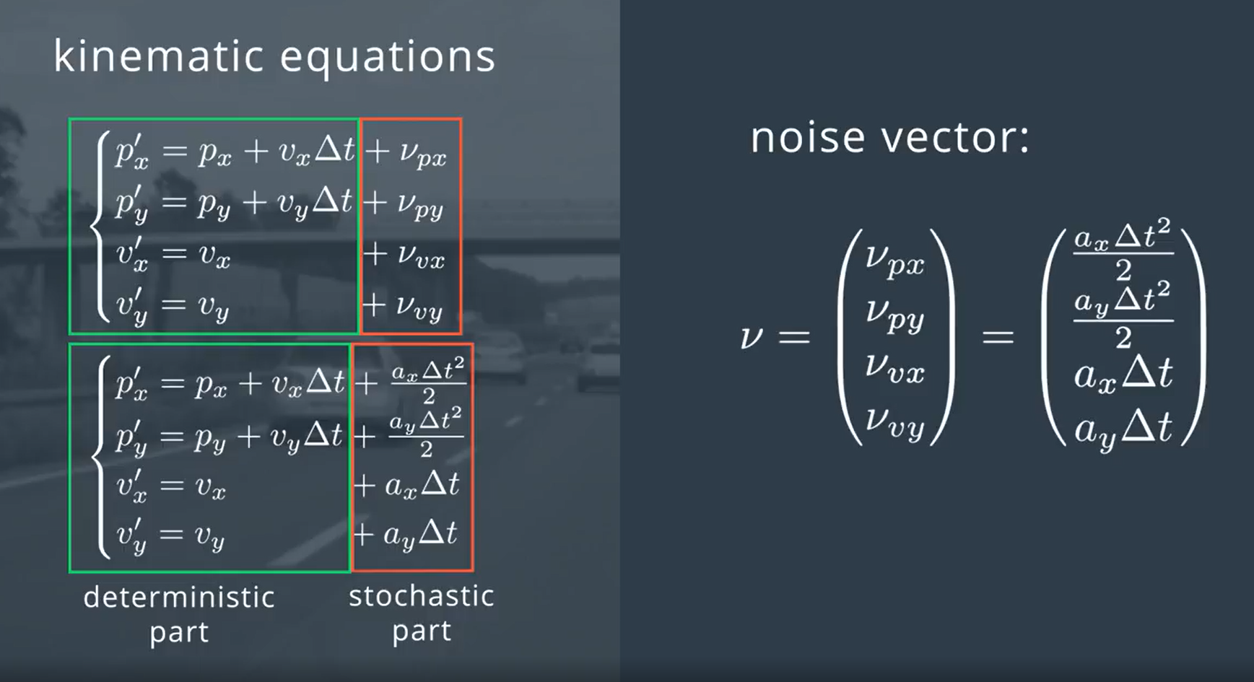
2D Linear Motion Model (Constant Velocity model)

Slide 35
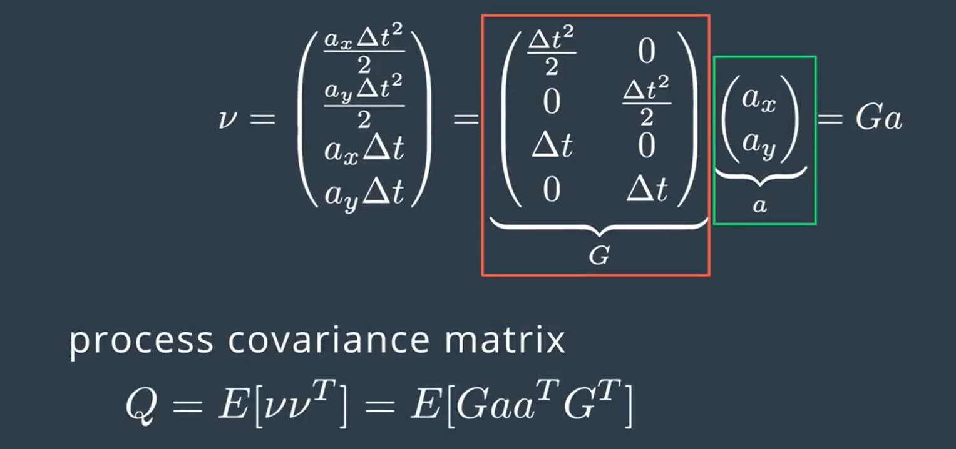
2D Linear Motion Model (Constant Velocity model)

Slide 36
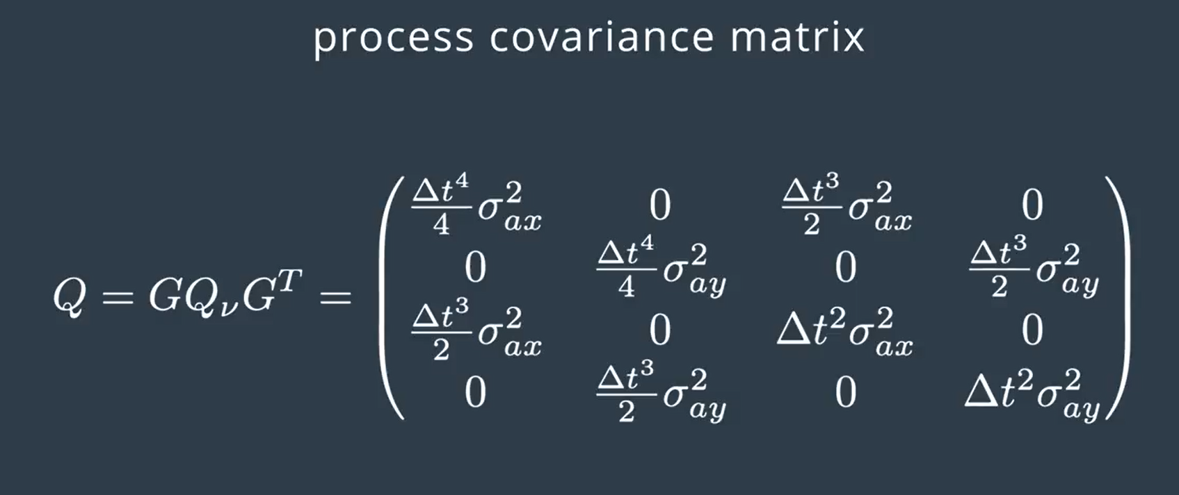
2D Linear Motion Model (Constant Velocity model)

Slide 37
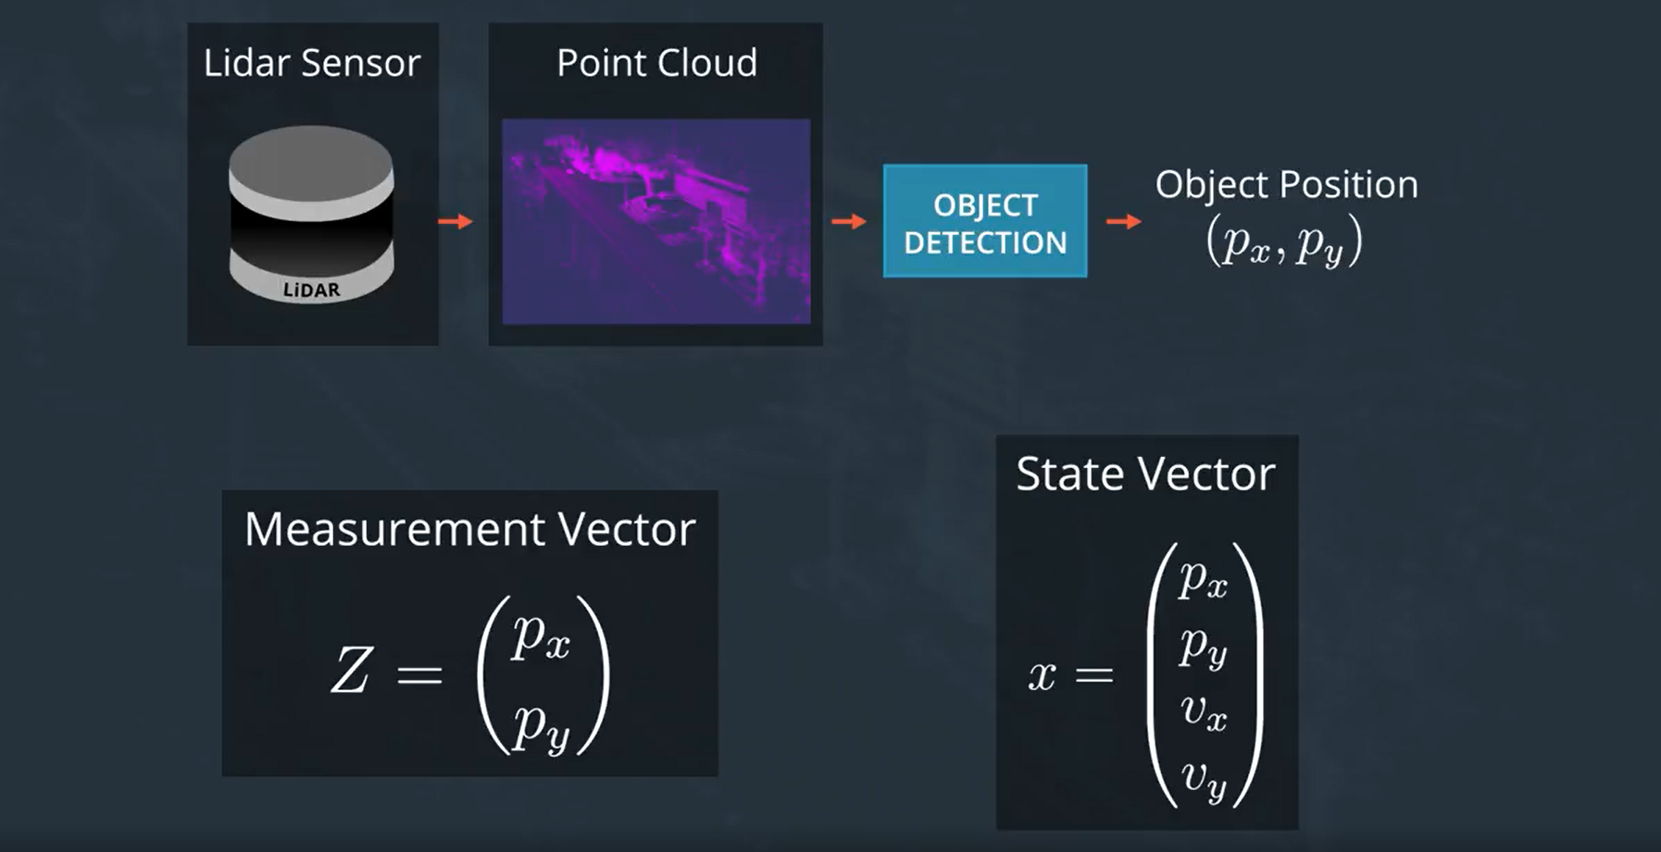
Lidar Measurement

Slide 38
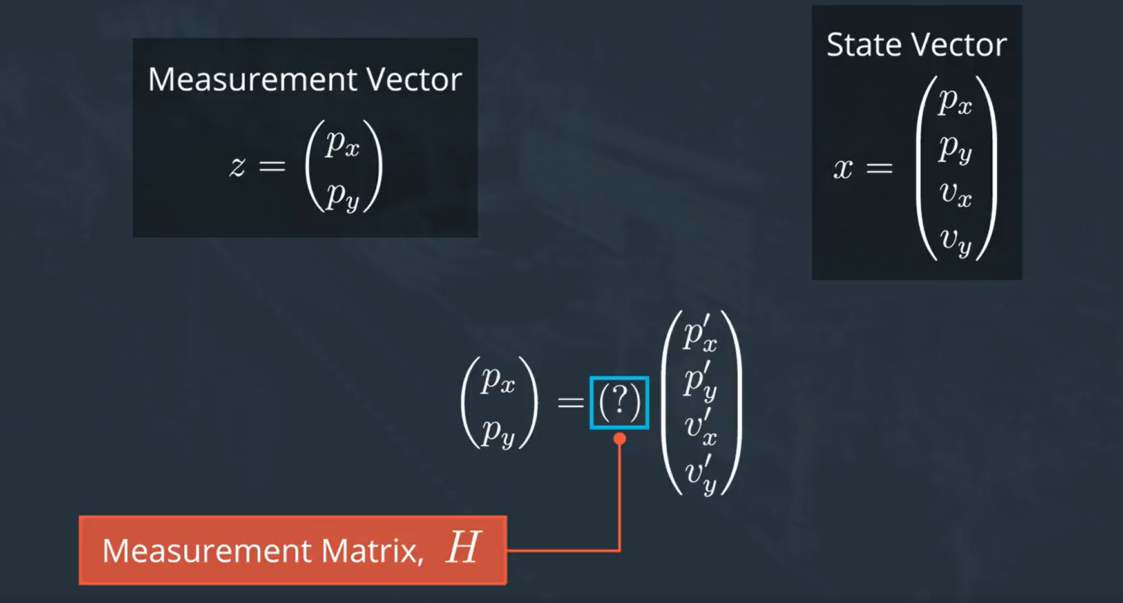
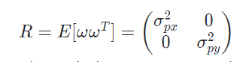
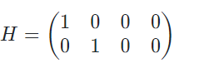
Lidar Measurement
Measurement noise Covariance Matrix
State Vector update

Slide 39
Kalman Filter Equations
Measurement Transformation Matrix
Meas. Vector
State Vector update
state Transformation matrix
Measurement noise Covariance Matrix
Process noise
state Vector
Kalman Gain
Process noise Covariance Matrix
State Covariance Matrix update
State Covariance Matrix

Slide 40
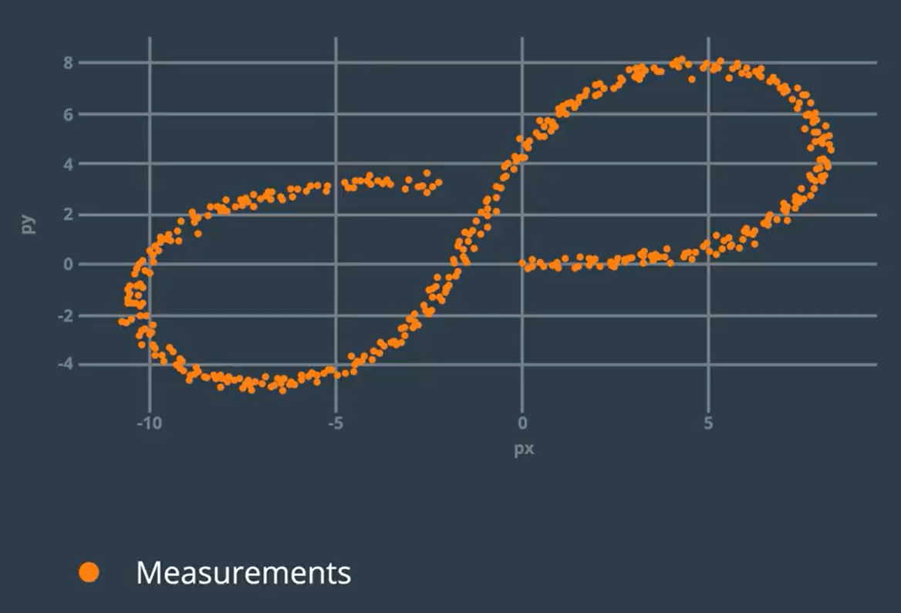
Laser Measurements Quiz: Code

Slide 41
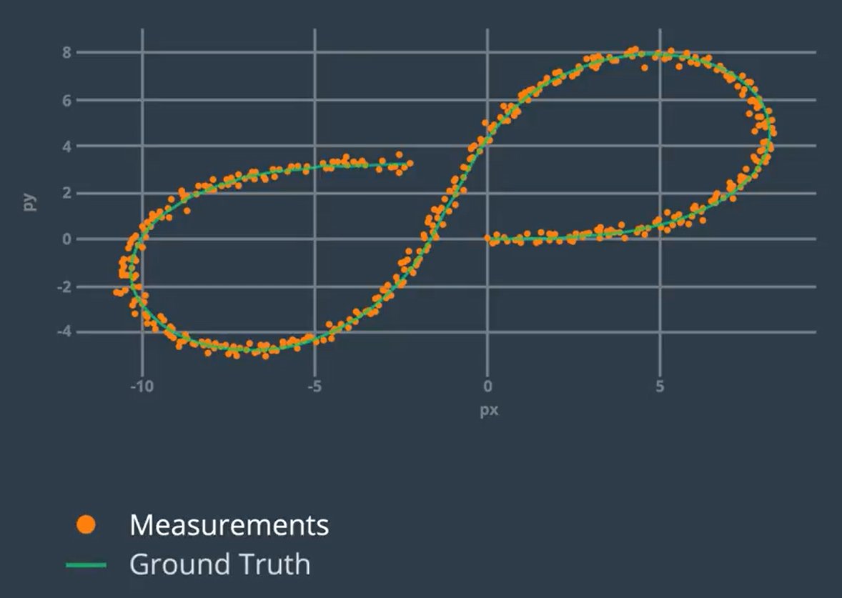
Laser Measurements Quiz: Code

Slide 42
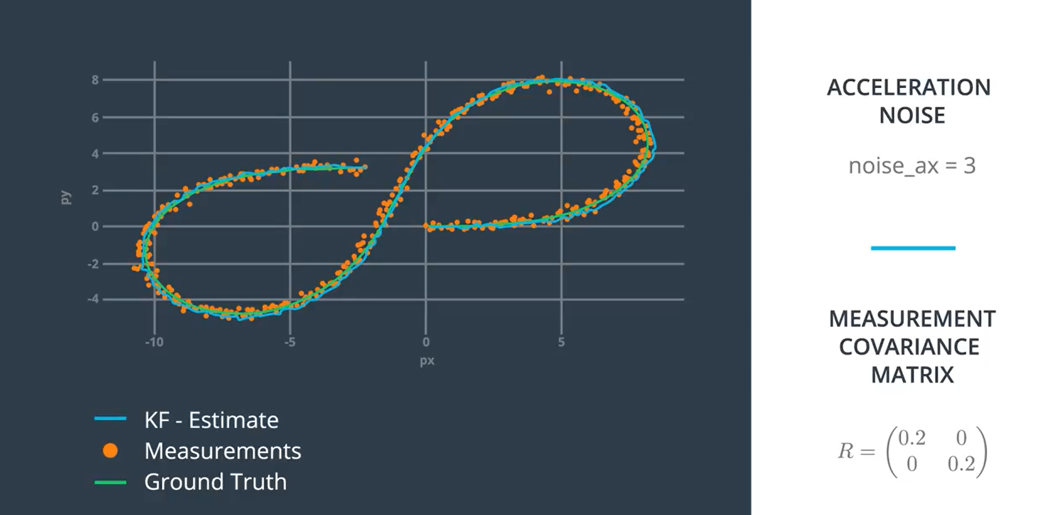
Laser Measurements Quiz: Code

Slide 43
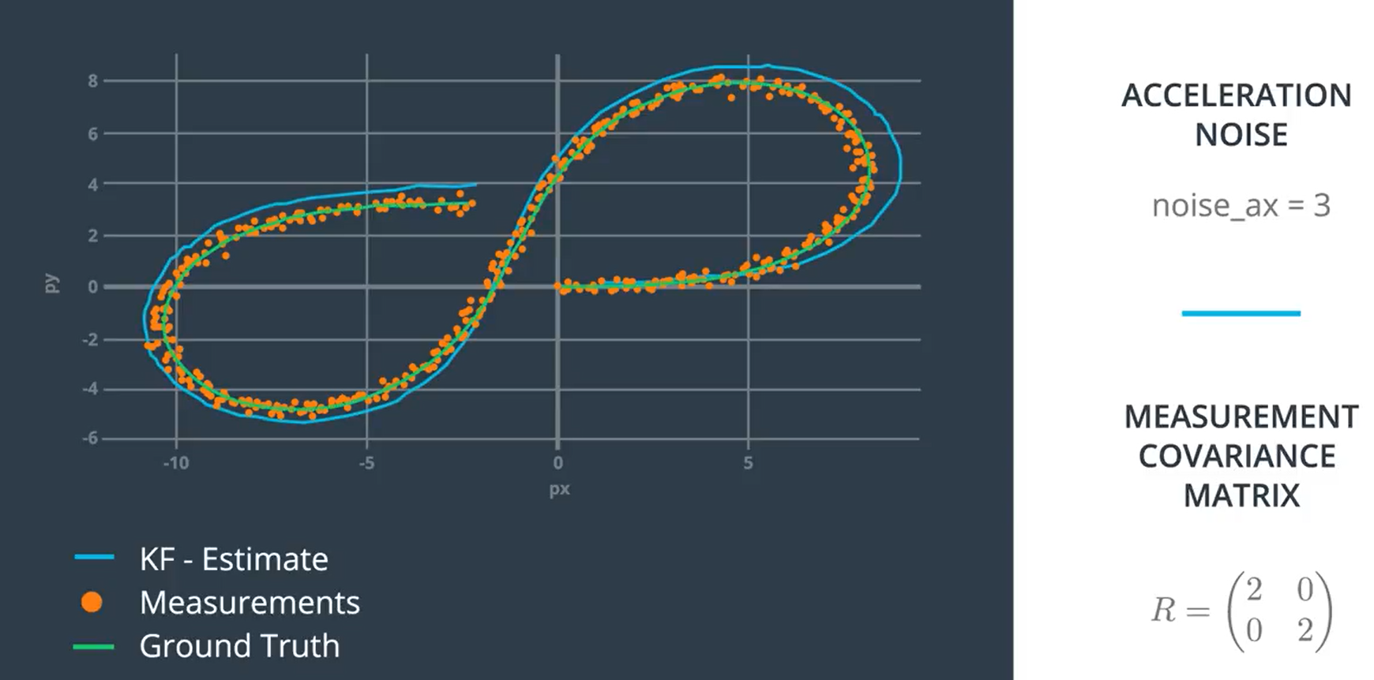
Laser Measurements Quiz: Code

Slide 44

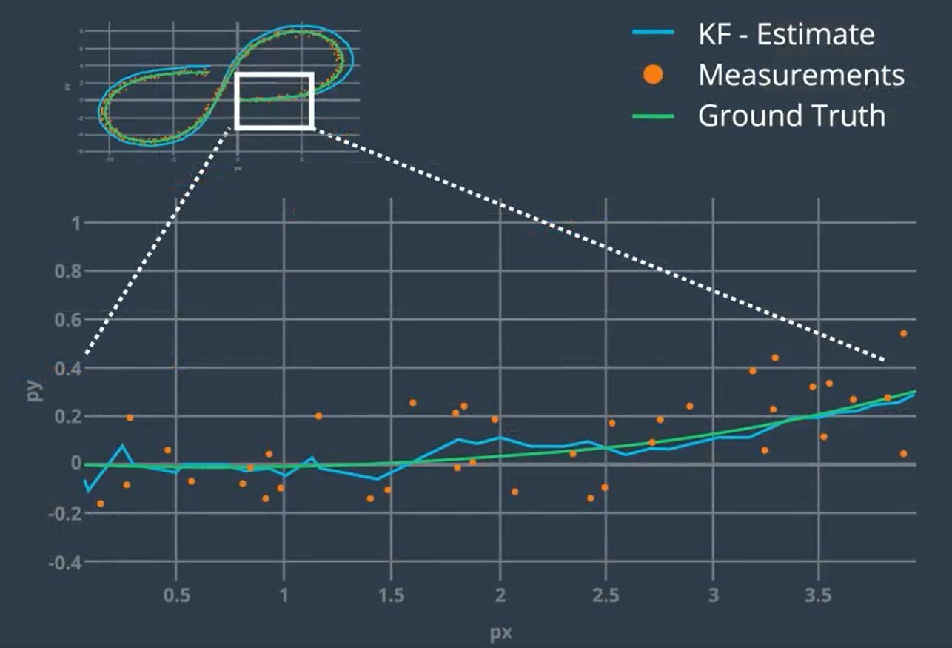
Laser Measurements Quiz: Code

Slide 45

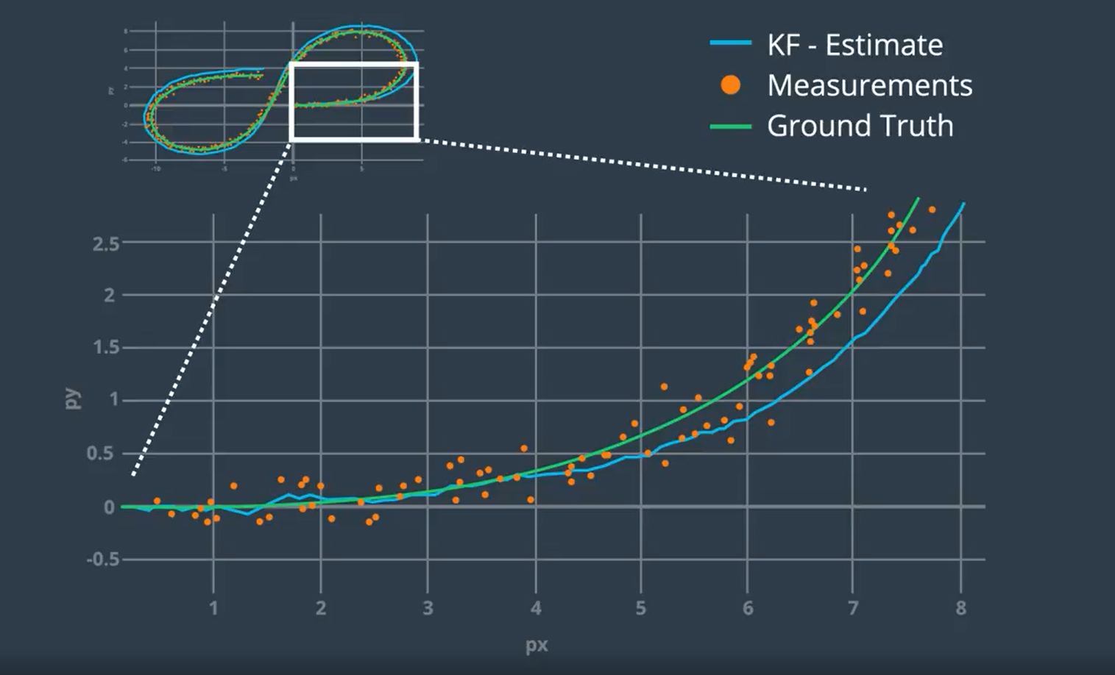
Laser Measurements Quiz: Code

Slide 46
Kalman Filter Road Map

Slide 47
Is linear Kalman Filter enough ????
Sources of nonlinearity:
Motion Model (State Transformation Function)
Measurement Transformation Function
Solutions:
Extended Kalman Filter
linearize the nonlinearity and continue normally
Unscented Kalman Filter !!!!!!

Slide 48
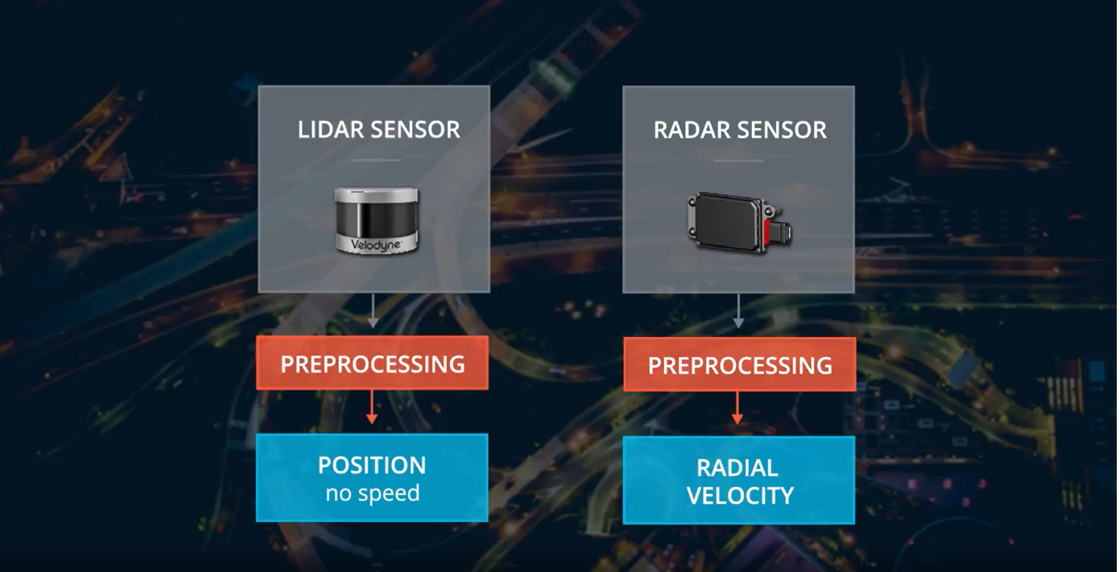
Radar Measurement

Slide 49
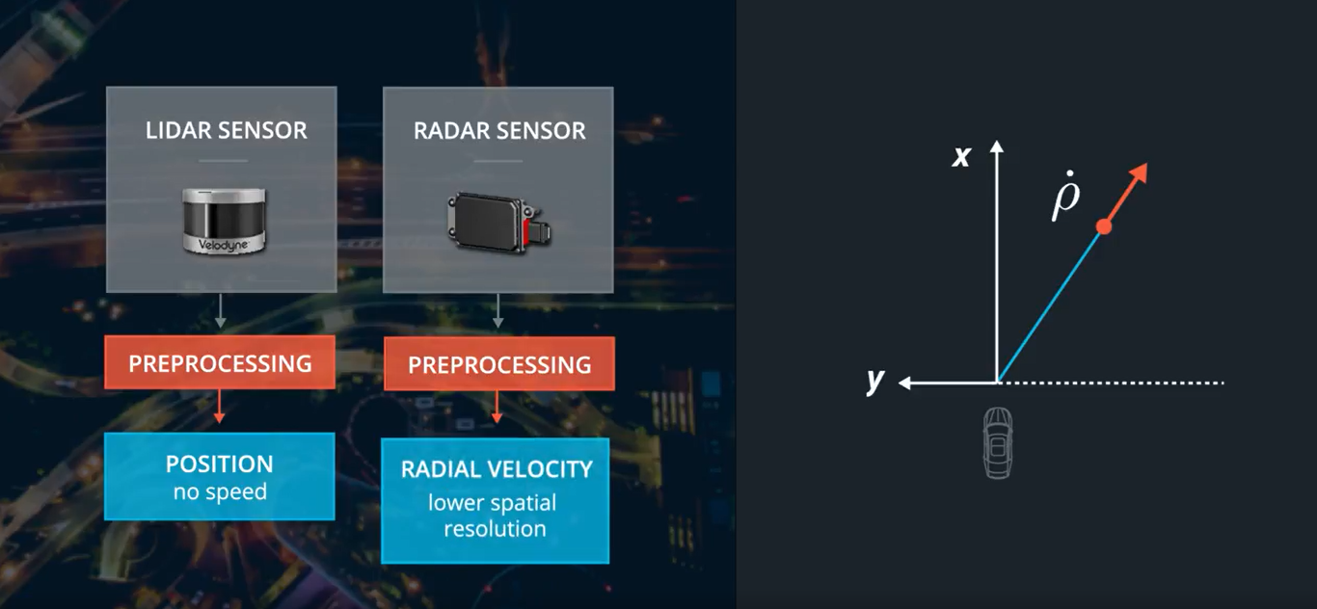
Radar Measurement

Slide 50
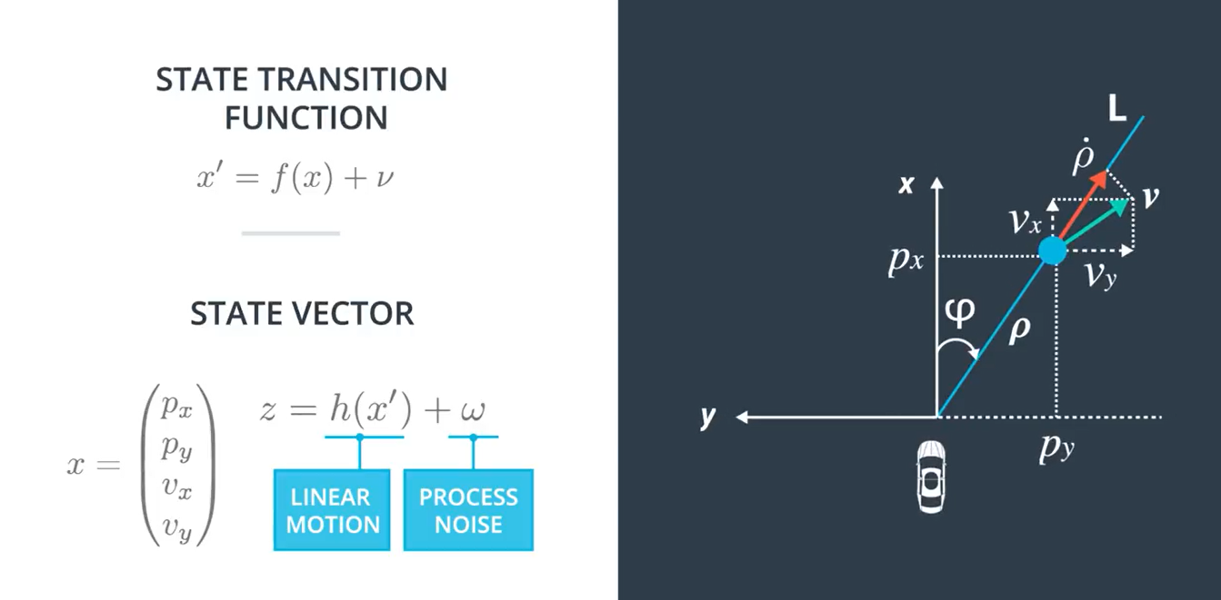
Radar Measurement

Slide 51
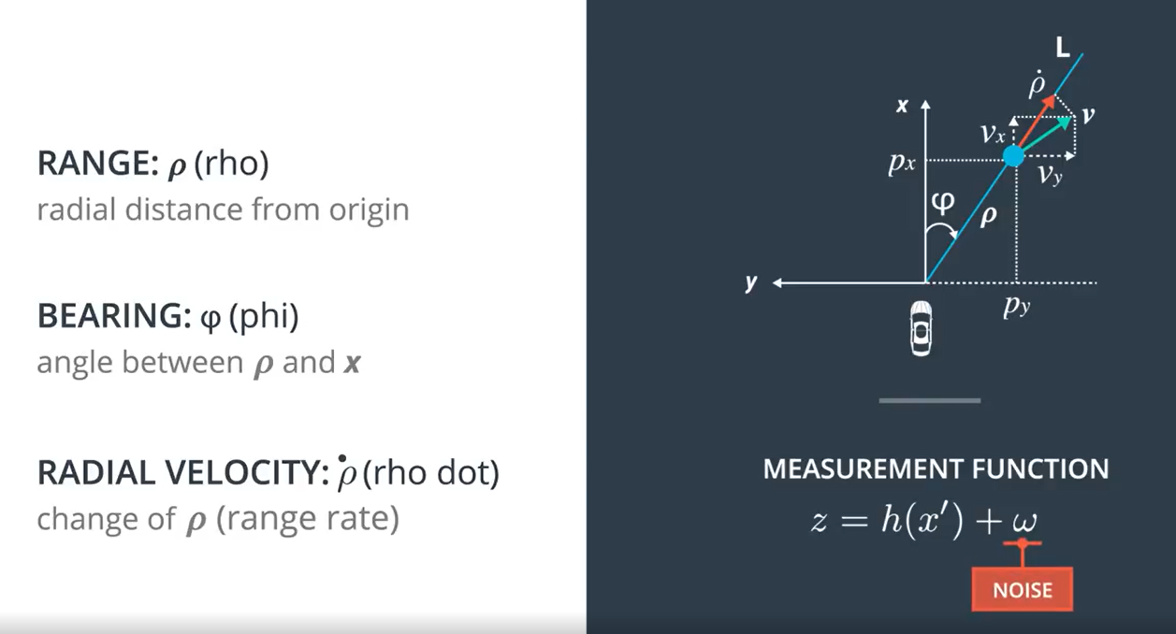
Radar Measurement

Slide 52
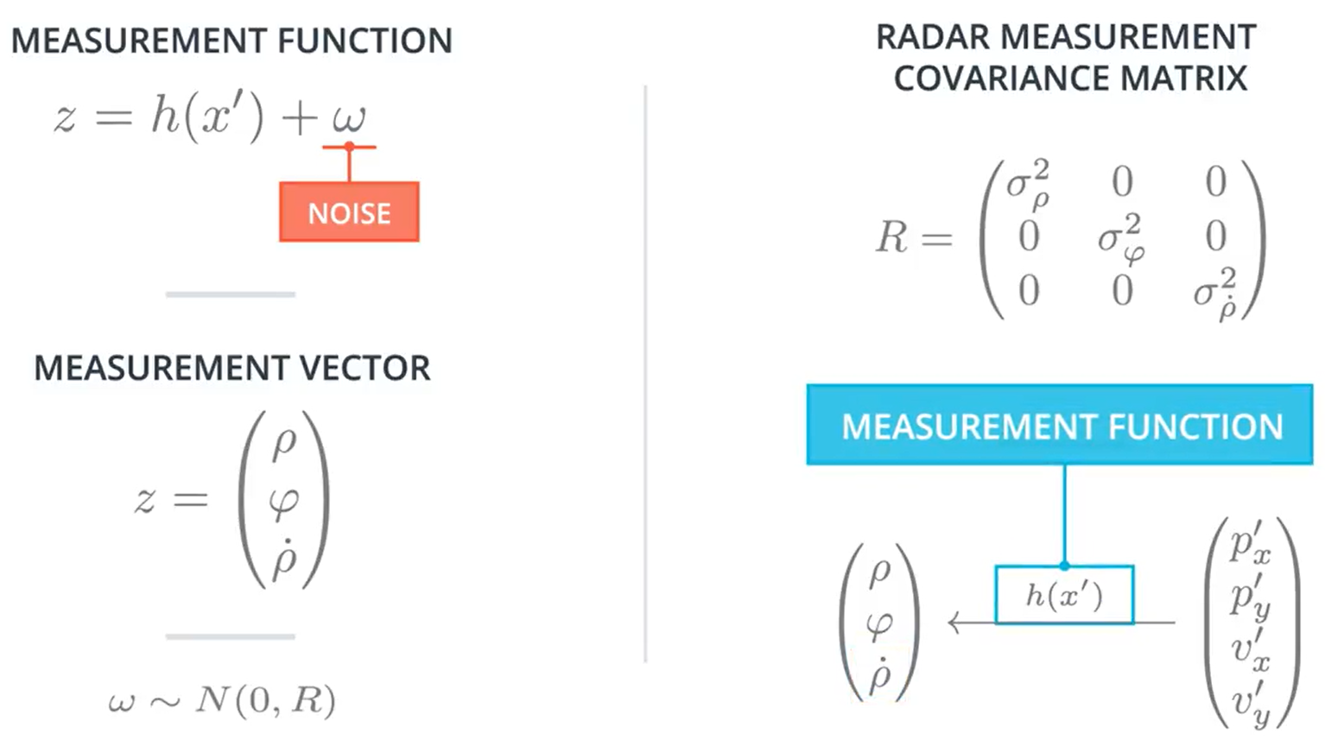
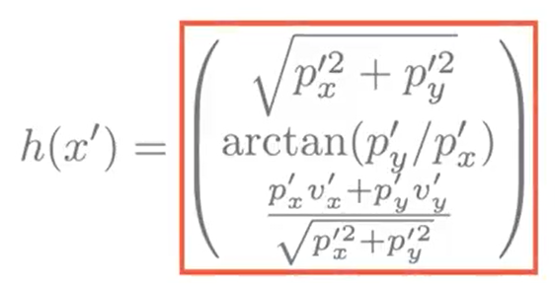
Radar Measurement
NonLinear !!!

Slide 53
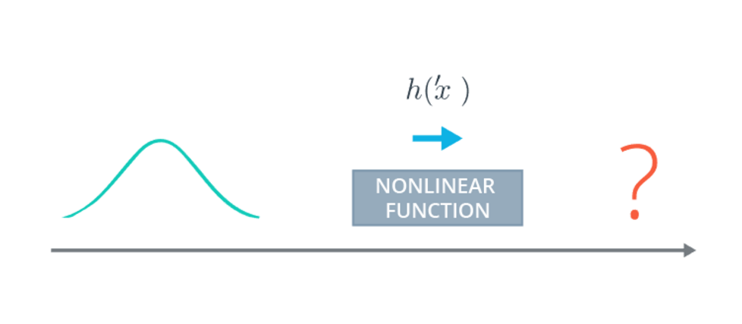

Radar Measurement

Slide 54

Nonlinear Transformation of Gaussian

Slide 55

Extended Kalman Filter Idea

Slide 56

Extended Kalman Filter Idea

Slide 57

Extended Kalman Filter Idea

Slide 58



Multi-Variant Taylor Series Expansion

Slide 59

Back to Radar Measurements

Slide 60
Code: Jacobian Matrix Programming Quiz

Slide 61


EKF Algorithm Generalization
Since we are still using constant velocity model so for the prediction step, we can still use the regular Kalman filter equations and the F matrix rather than the extended Kalman filter equations.

Slide 62

EKF Algorithm Generalization

Slide 63

Code: Evaluating KF Performance

Slide 64
Code: RMSE

Slide 65
Unscented Kalman Filters in C++

Slide 66

The CTRV Model
Motion Models and Kalman Filters
constant turn rate and velocity magnitude model (CTRV)
constant turn rate and acceleration (CTRA)
constant steering angle and velocity (CSAV)
constant curvature and acceleration (CCA)

Slide 67

The CTRV Model

Slide 68

The CTRV Model

Slide 69

The CTRV Model

